Slide 1

MyHMI
Primary guidance in MyHMI framework development:
  vehicle infotainment and instrument cluster applications
extensions of those applications
  automation and process control industries

Slide 2
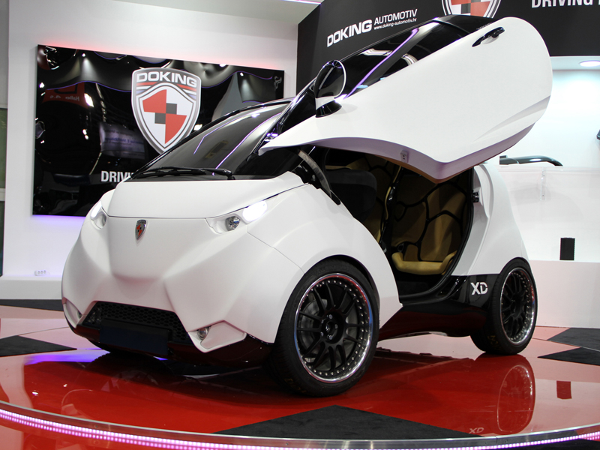
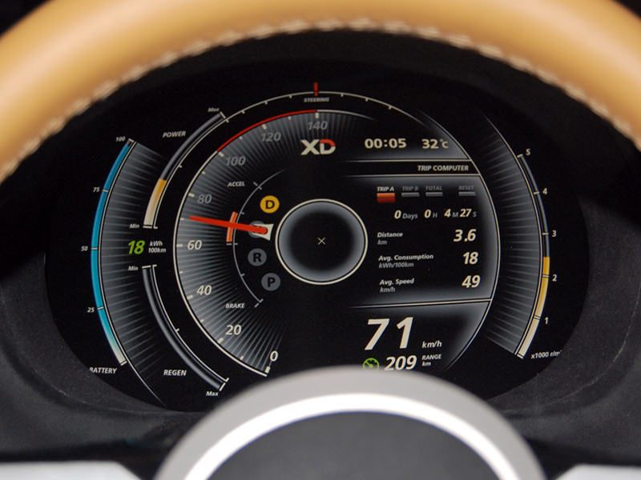
Beginnings of MyHMI development

Slide 3
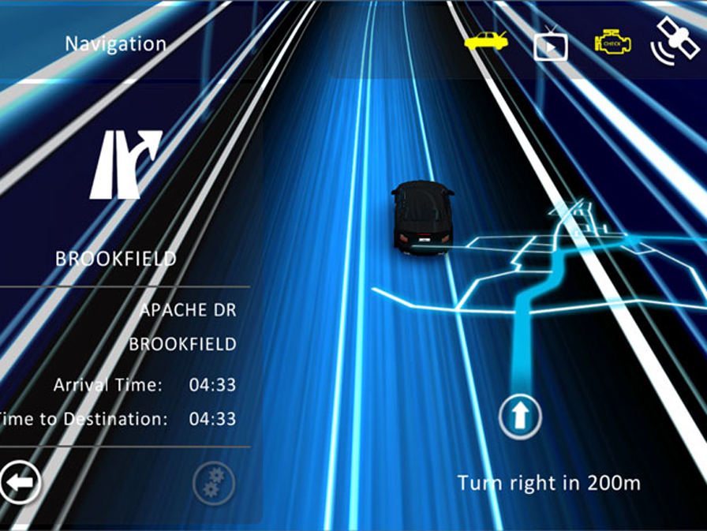
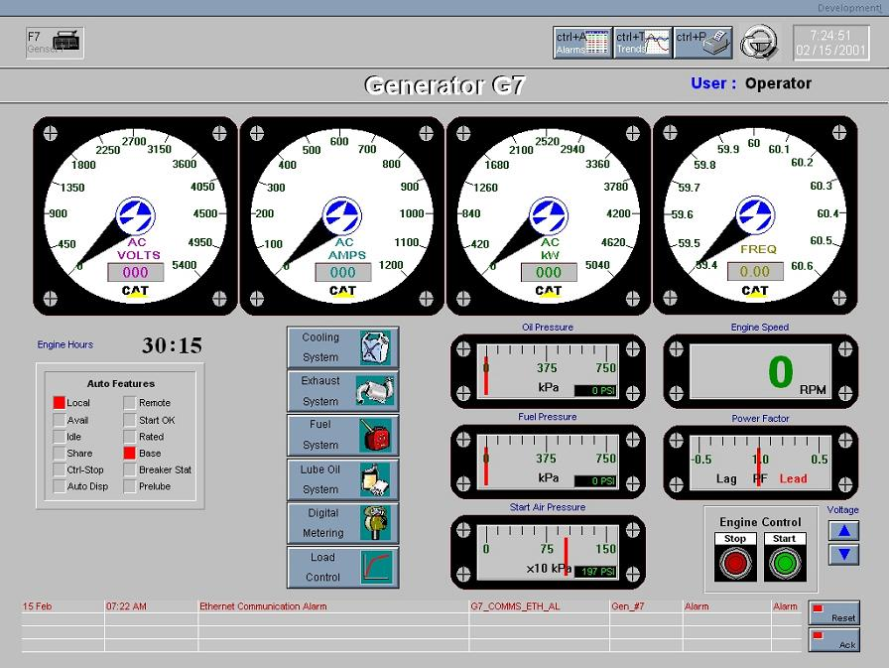
What HMI trends resulted in?
Deep gap in HMIs market:
Graphically expressive HMI solutions, with propreritary communication
and processing mechanisms
Solutions with vast processing and communication possibilities, but plain graphics

Slide 4
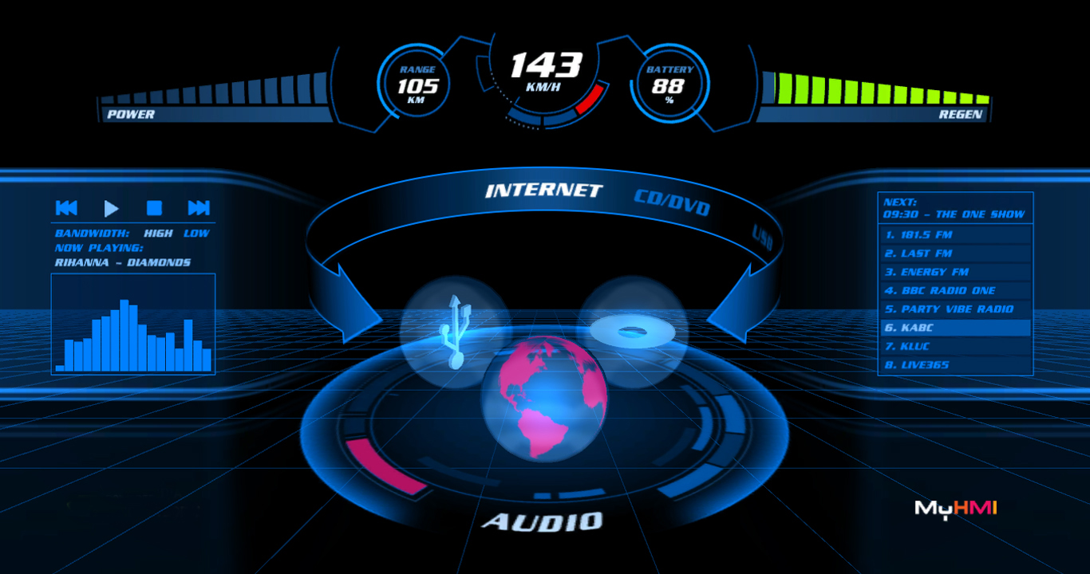
Bridging the gap

Slide 5
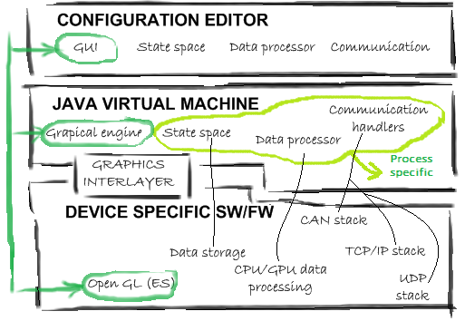
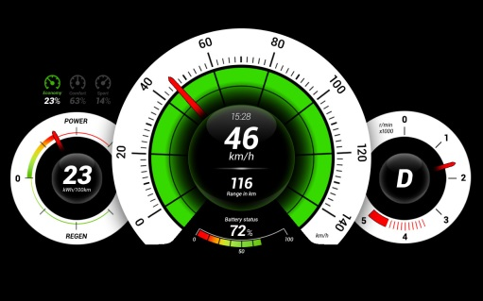
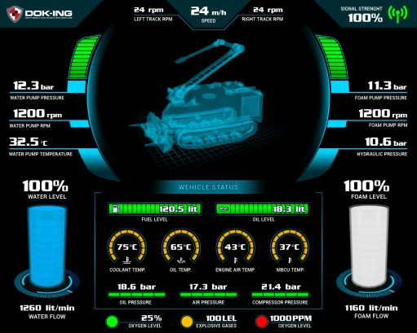
MyHMI & Jogamp
Designed as a multiplatform framework
  Java → CPU agnostic development
  Jogamp's Jogl → GPU agnostic development

Slide 6
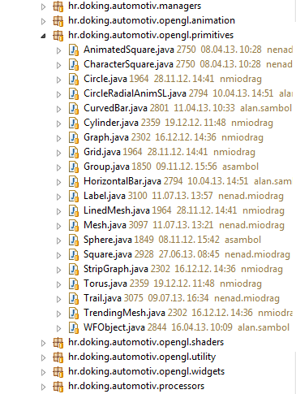
MyHMI framework
Modules
  Display (widgets, primitives, animations)
  Communication (UDP, TCP/IP, CAN, serial...)
  Data processing

Slide 7
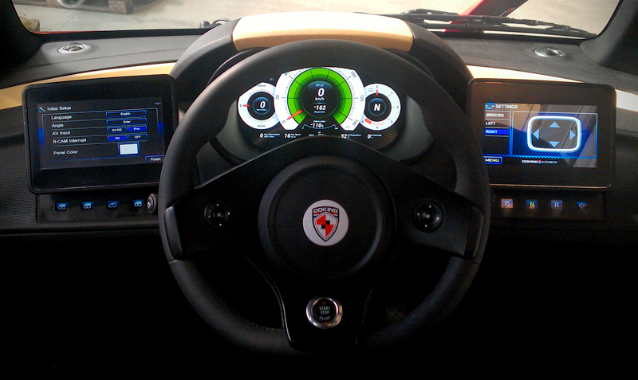
MyHMI approvals in industries
LOOX instrument cluster

Slide 8
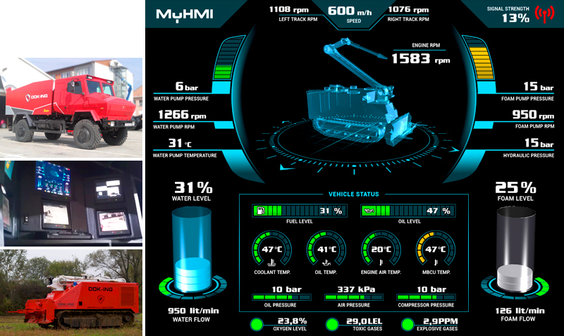
MyHMI approvals in industries
UNIMOG control center

Slide 9
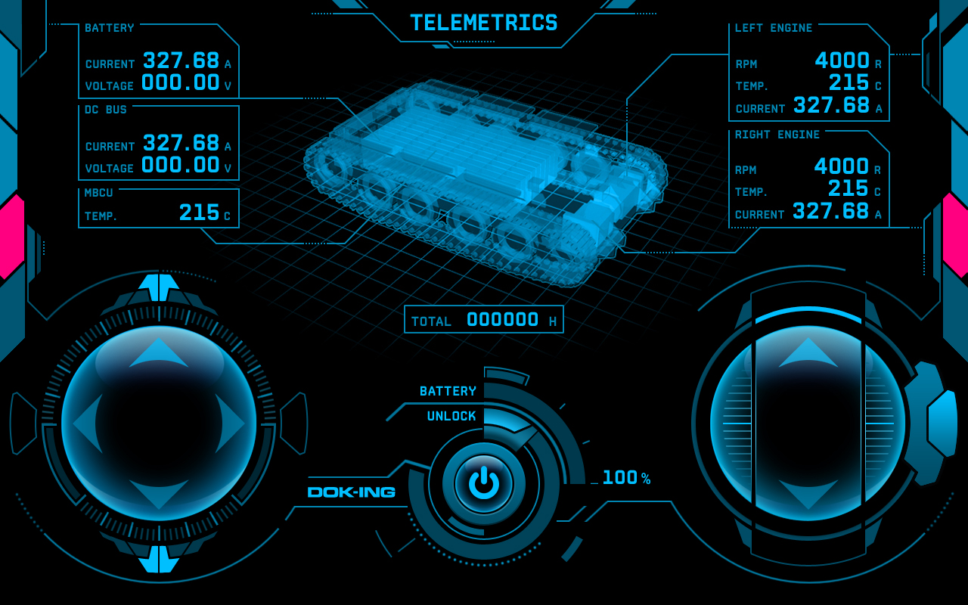
MyHMI approvals in industries
SCADA / remote control

